Slide 1
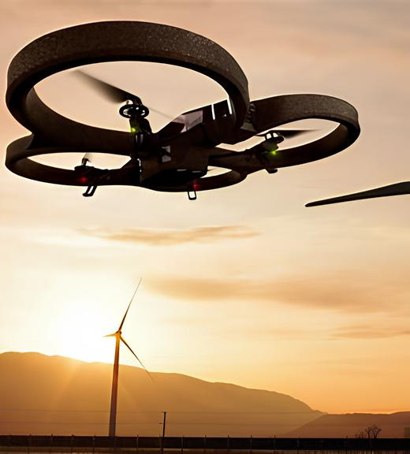
University of Bourgogne
MSFT
Multi Sensor Fusion and Tracking
ARUCO MARKER TRACKING
Yiren QIU
Ghous Iqbal
Yihao LIAO

Slide 2

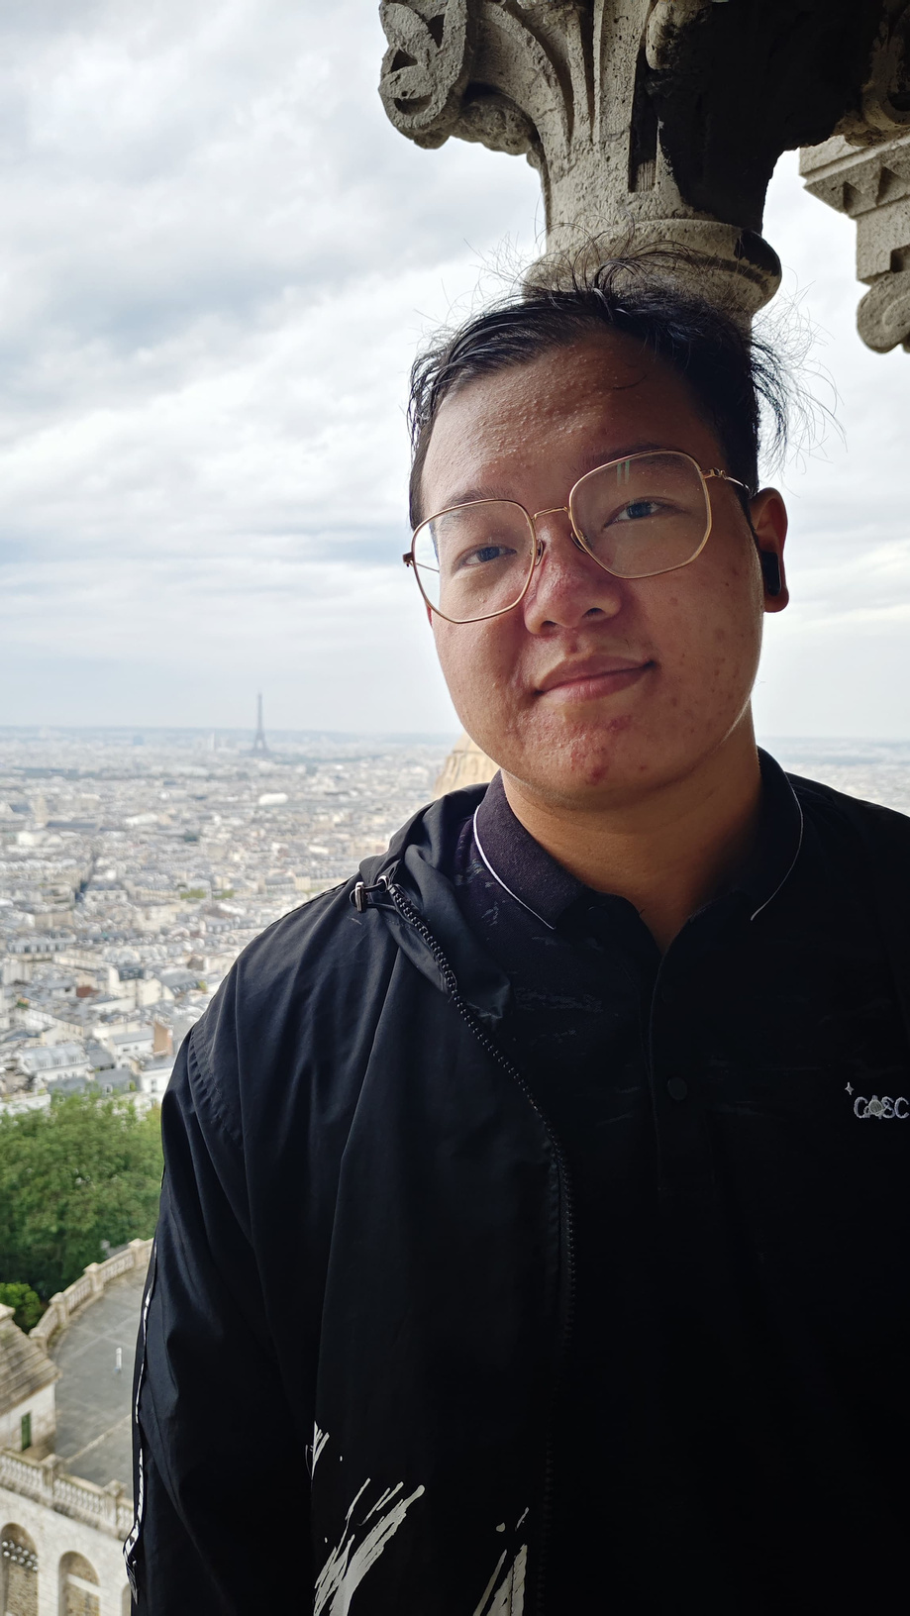
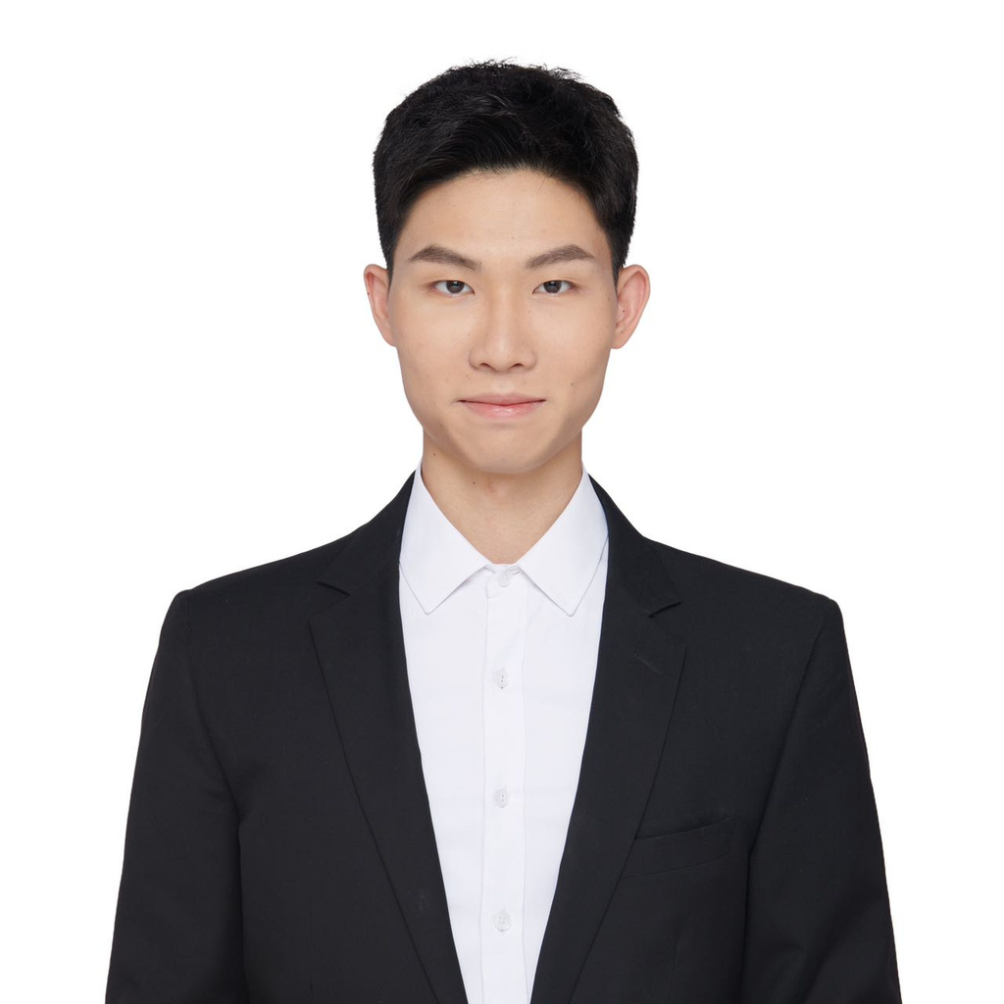
University of Bourgogne
Our Team
Ghous Iqbal
Yiren QIU
Yihao LIAO
In order to successfully complete the assignments required for this course, we have carefully assembled a professional team of three dedicated members. These individuals, each possessing their own unique set of skills and expertise, have come together with the common goal of collaborating on the task of aruco marker tracking for drones. This strategic decision to form a team was made in recognition of the importance of teamwork, the value it brings to complex tasks, and the need to harness the collective strengths of all team members in order to achieve optimal results.

Slide 3
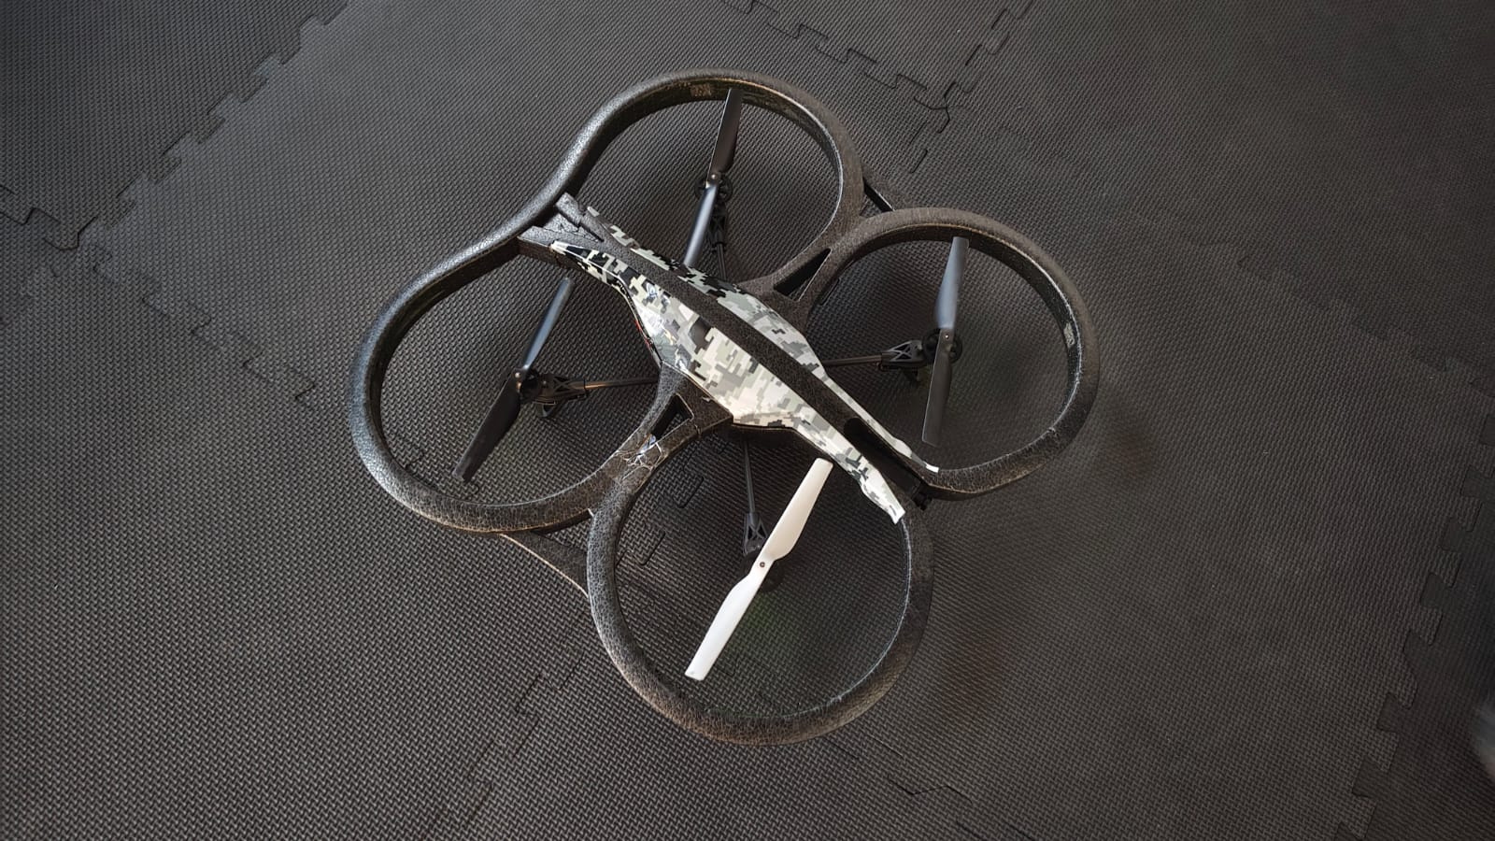
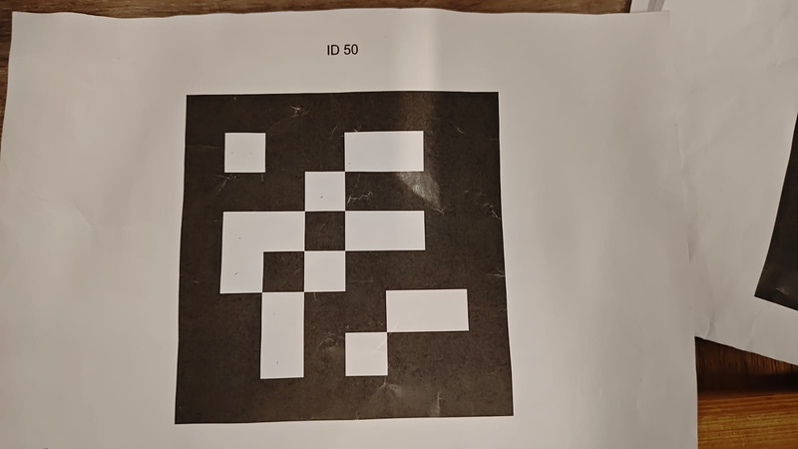
University of Bourgogne
Introduction
Parrot Drone 2.0 Hardware
Aruco Marker Tracking
A drone, or Unmanned Aerial Vehicle (UAV), is a aircraft that can fly without a human pilot, using either remote control or pre-programmed flight paths. They are used in many industries for their efficiency and versatility. The Parrot AR.Drone 2.0 is a beginner-friendly quadcopter, used for capturing videos and photos with its onboard cameras. It has Wi-Fi connectivity, sensors for stable flight, and is equipped with user-friendly software, making it perfect for recreational flying and basic aerial photography.
ARUCO markers are used in drone tracking to enable the drone to detect, identify, and track predefined markers for tasks such as navigation, localization, and object tracking. These markers serve as visual landmarks for the drone's onboard camera, allowing for precise positioning and target following.

Slide 4

University of Bourgogne
Meaningful !
Aruco marker tracking is a valuable solution for various positioning and localization challenges, especially when GPS is ineffective or impractical. The technology enables precise detection of position and orientation, facilitating advancements in industries like robotics, augmented reality, and industrial automation. In robotics, it allows for more accurate navigation, while in augmented reality, it enhances precision of overlaying digital content onto the real world. In industrial automation, it improves factory floor operations, and in agriculture, it aids in precise navigation of farming equipment and enhances crop monitoring and yield estimation. In healthcare, it aids surgeons in accurate position detection during complex procedures. This implementation of Aruco marker tracking has made tasks in these industries smarter, safer, and more efficient.
Aruco marker detection influence our life!

Slide 5
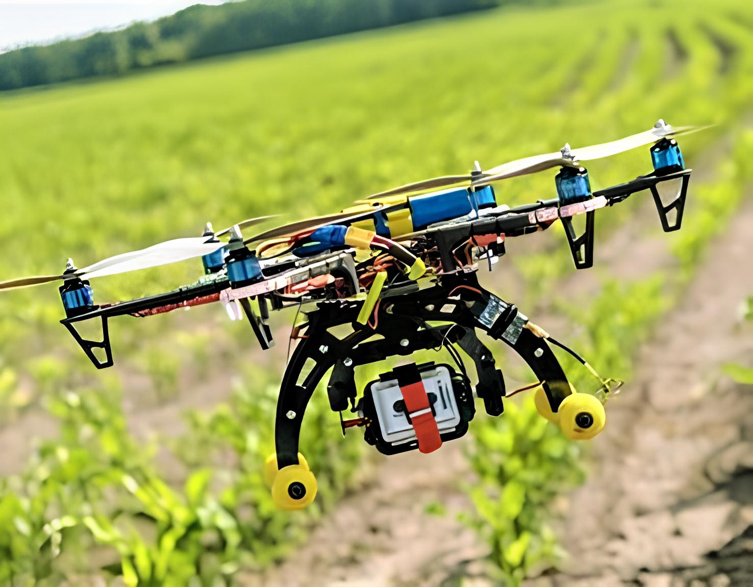
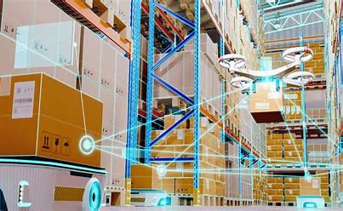
University of Bourgogne
Aruco marker tracking is a versatile and reliable technique for positioning, localization, and pose estimation in various real-world applications !
Meaningful !
Robotics and Autonomous Navigation
Augmented Reality (AR)
Example:
Drone Delivery Systems: Drones can use Aruco markers placed on landing pads to identify exact drop-off points.
Autonomous Robots: Robots in warehouses or factories identify markers to determine their position or align with machinery.
Significance:
Ensures high accuracy and robustness in environments where GPS is unreliable, such as indoor spaces.
Virtual Object Placement: Placing virtual objects (like furniture in a room) using AR applications.
Interactive Learning: AR educational tools use markers to display additional information or animations.

Slide 6
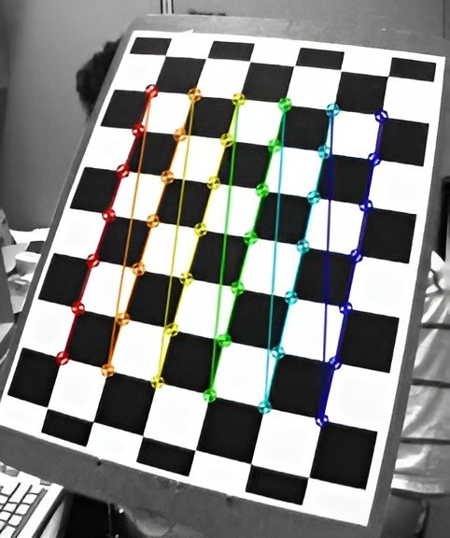
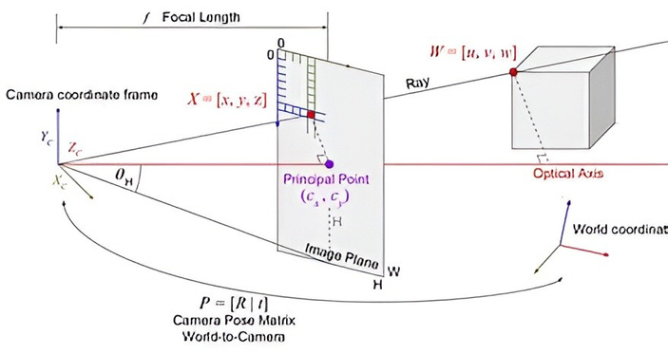
University of Bourgogne
Camera Clibration
Objective of Calibration
Purpose: Correct camera lens distortion and determine intrinsic parameters:
Camera Matrix (focal length, optical center)
Distortion Coefficients (correct lens distortion).

Slide 7
University of Bourgogne
Initialization:
Connect and configure the drone using ps-drone API.
Activate front camera and set video parameters.
Camera Clibration
drone.startup()
drone.frontCam()
drone.start
Data Collection
Capture 30 images of the chessboard at various angles and positions.
Convert images to grayscale for corner detection.
Detect the chessboard corners using cv2.findChessboardCorners.
Refine corner positions with sub-pixel accuracy.
grayscaleImage = cv2.cvtColor(colorImage, cv2.COLOR_BGR2GRAY)
ret, corners = cv2.findChessboardCorners(grayscaleImage, (6,8), None)
cv2.cornerSubPix(grayscaleImage, corners, (11,11), (-1,-1), criteria)
Data Storage
Store 3D object points (real-world coordinates) and 2D image points:
Object points: grid coordinates.
Image points: detected corners in the image.
objpoints.append(objp)
imgpoints.append(corners)
Calibration Calculation
Use cv2.calibrateCamera to compute:
Camera Matrix
Distortion Coefficients
Output:
ret: Re-projection error.
mtx: Intrinsic Camera Matrix.
dist: Distortion Coefficients.
rvecs and tvecs: Rotation and Translation Vectors.
ret, mtx, dist, rvecs, tvecs = cv2.calibrateCamera(objpoints, imgpoints, grayscaleImage.shape[::-1], None, None)

Slide 8
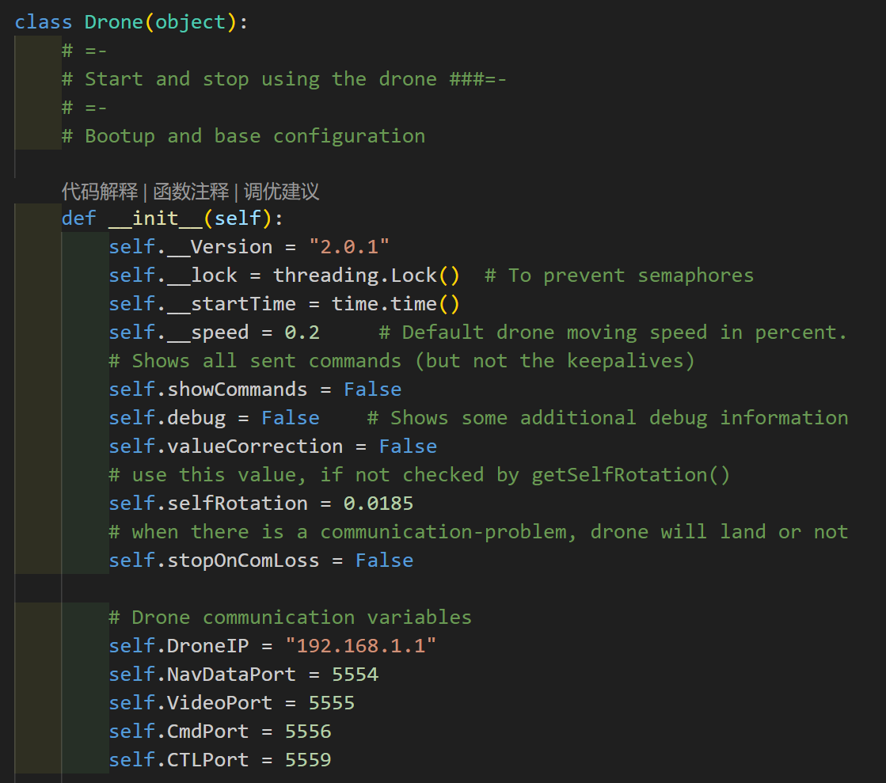
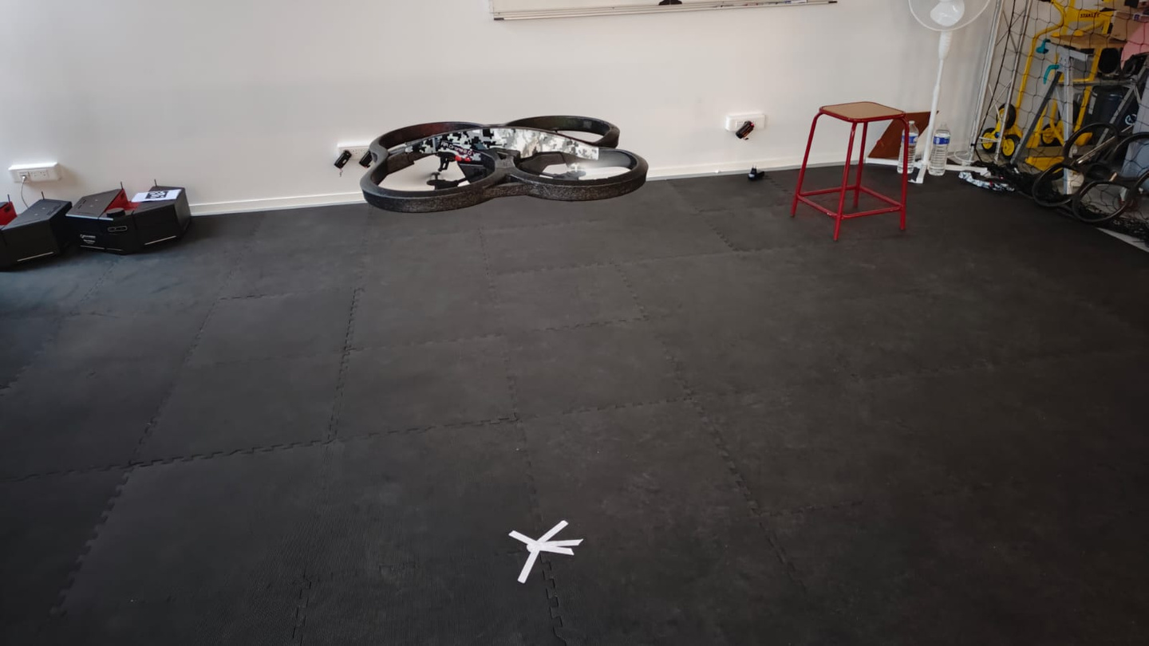
University of Bourgogne
PS-Drone Lib
The PS-Drone is a Python-based API for Parrot's AR.Drone 2.0, designed for easy learning and full feature use. It was created as part of a computer science degree dissertation and can run on slow computers. The API allows for Sensor-Data, Configuration, and full Video-support, with OpenCV2 analysis possible. It is useful for teaching and professional purposes, and its nomenclature aligns with Parrot's SDK.
Key objectives of the project include:
Utilize ARUCO Marker Tracking to enable autonomous navigation and tracking tasks for drones. Control the Parrot AR.Drone 2.0 to fly, identify, and track ARUCO markers, achieving the following functionalities:
Marker Detection: Recognize ARUCO markers within the field of view and determine their IDs.
Position and Pose Estimation: Obtain the positional information of the markers relative to the drone.
Tracking and Action Response: Control the drone's movements to track or complete tasks based on the detected markers.

Slide 9
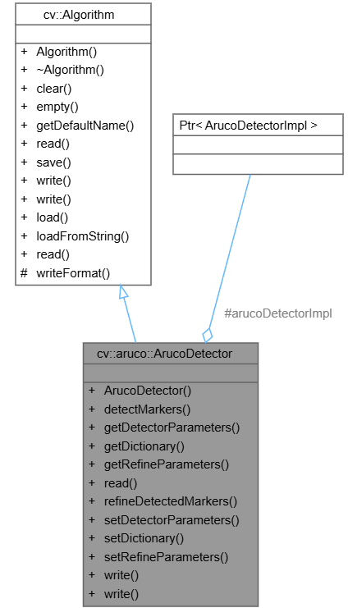
University of Bourgogne
The below UML class diagram represents the OpenCV ARUCO marker detection process, focusing on the cv::aruco::ArucoDetector class and its relationship with cv::Algorithm. Here's an explanation of the ARUCO detection method and the role of these classes:
Marker Detection
Step 1: Preparation
Objective: Detect ARUCO markers in the drone's camera view and extract their IDs.
Tools and Libraries:
Use OpenCV and ARUCO modules for image processing and marker detection.
Utilize the drone’s onboard camera for real-time video capture.
Environment Setup:
Install necessary Python libraries:
opencv-python；opencv-contrib-python； numpy
Configure the Parrot AR.Drone 2.0 and start the video stream.
Step 2: Video Capture
Objective: Capture real-time video frames from the drone’s front-facing camera.
Step 3: Preprocessing
Objective: Convert the video frames to grayscale for simpler and faster processing.

Slide 10
University of Bourgogne
Aruco Marker Det
Key Concepts of ARUCO Marker Detection
ARUCO marker detection in OpenCV is based on identifying predefined binary patterns in the image using computer vision techniques. The process typically involves:
Input Image Preprocessing:
Convert the input image to grayscale.
Apply thresholding or adaptive thresholding to enhance the binary marker visibility.
Marker Detection:
The detection algorithm identifies square-shaped regions in the image.
The detected regions are analyzed to see if they match any marker patterns defined in a dictionary (like 4x4, 6x6 markers).
If a match is found, the marker ID and corner points are extracted.
Output:
The system returns:
Marker IDs.
The corner coordinates of each detected marker.
Optionally, refined corner positions for better accuracy.

Slide 11
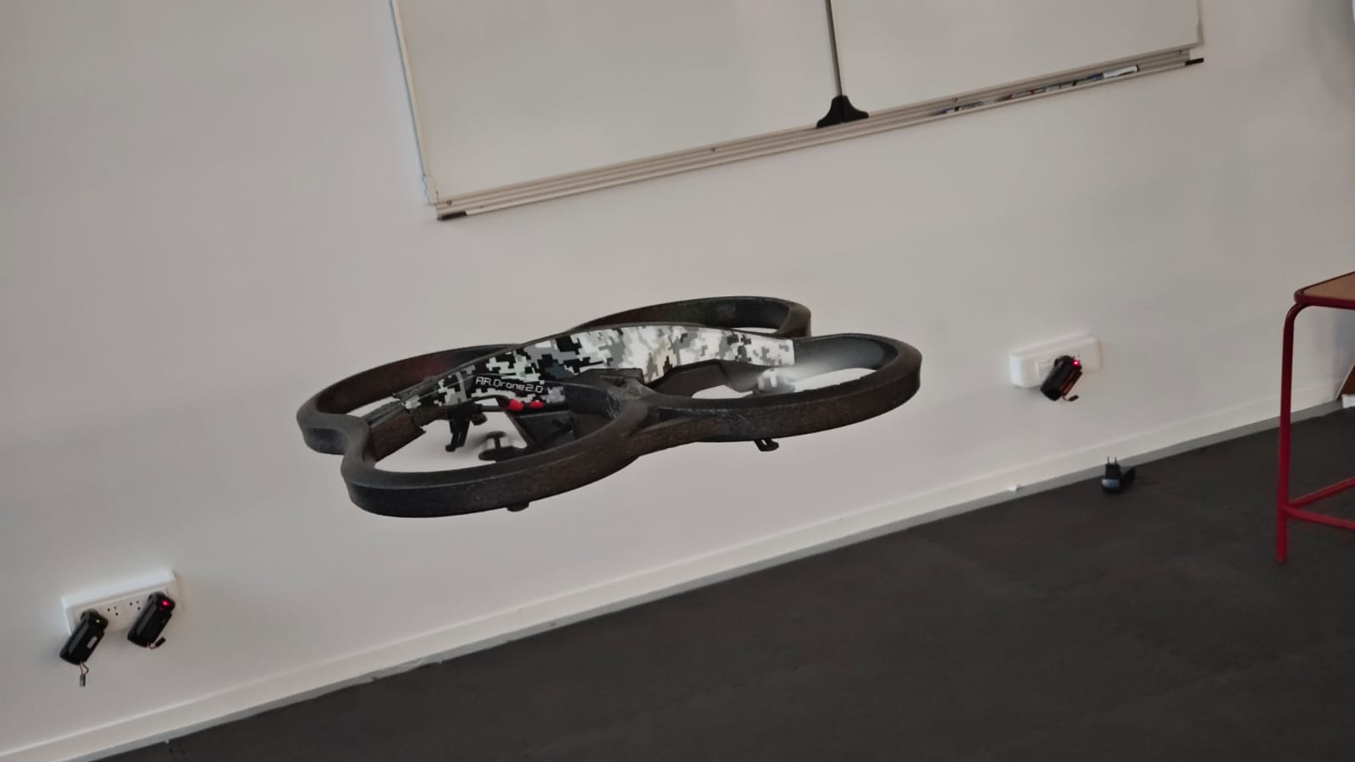
University of Bourgogne
Position and Pose Estimation
Pose Estimation of the ARUCO Marker
Pose Calculation:
cv2.aruco.estimatePoseSingleMarkers() estimates the translation vector and rotation vector of detected markers.
Translation vector provides the 3D position of the marker relative to the camera.
Center-to-Center Distance:
Calculate the horizontal and vertical error between:
Marker center.
Drone camera’s central point (e.g., at (320, 160)).

Slide 12
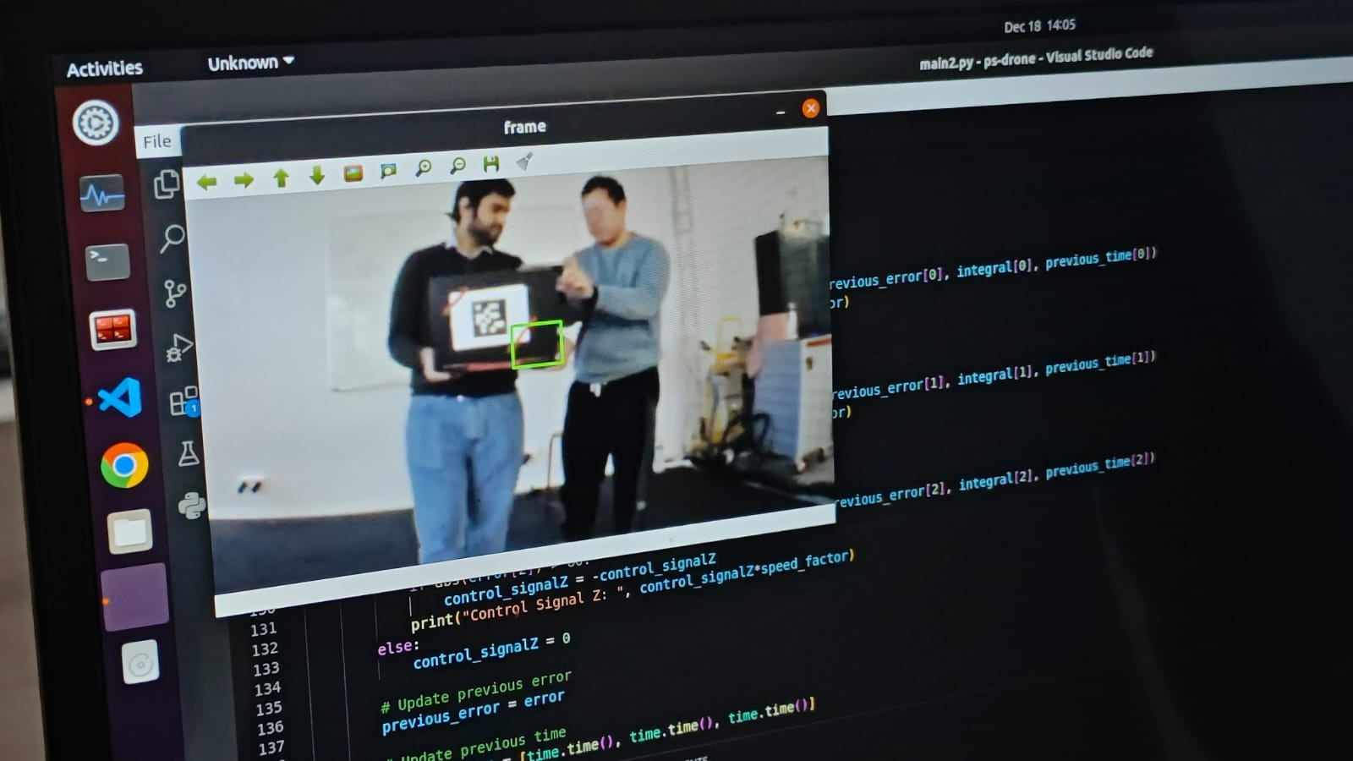
University of Bourgogne
Tracking and Action Response
As we continue to enhance robustness within our construction projects, the following future goals and improvements will be prioritized:
PID Control for Drone Positioning
Goal:
Correct the drone's position to center the ARUCO marker and stabilize distance.
Errors:
error = [distance_x, distance_y, distance_z]:
distance_x: Horizontal error.
distance_y: Vertical error.
distance_z: Depth (distance to the marker).
PID Algorithm:
Implement PID control for position correction:
Proportional (Kp): Reduces current error.
Integral (Ki): Eliminates steady-state error.
Derivative (Kd): Predicts future error.
Compute control signals:
control_signal = Kp * error + Ki * integral + Kd * derivative
Conditions for Control:
Adjust drone's motion only when errors exceed a threshold:
Horizontal: > 55 pixels.
Vertical: > 40 pixels.
Depth: Out of 60–80 range.

Slide 13
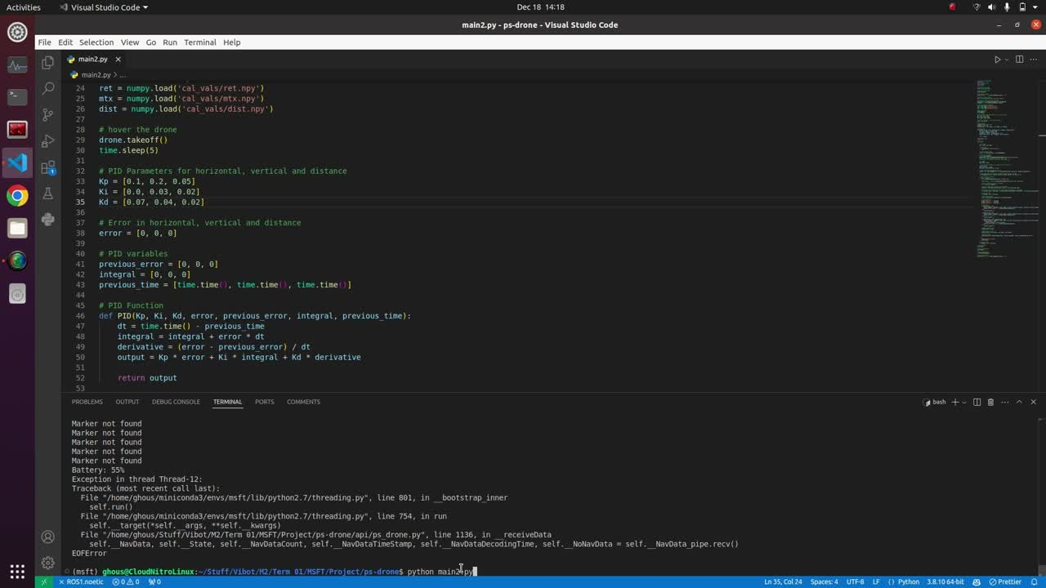
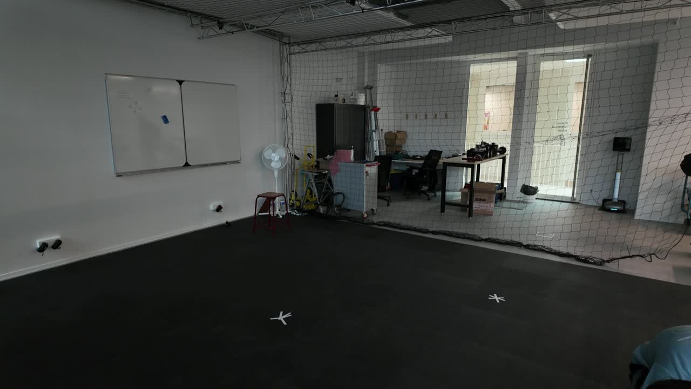
University of Bourgogne
Experiments
Ubuntu Screen Recording Result
Actual performance Recording Result
Here are the results that we have been able to achieve thus far in our aruco marker detection project, which has been an intensive and collaborative effort involving a multidisciplinary team of experts.
The results reported are both recorded at the same time

Slide 14

University of Bourgogne
Thank You!
In the context of our comprehensive Multi-sensor fusion tracking course, we have meticulously gathered and presented all the relevant answers related to Aruco Marker Tracking that we could find. This exhaustive list of responses serves as a one-stop solution, catering to the diverse queries and concerns that may arise in this subject area. We would like to express our deepest gratitude for your undivided attention as you navigate through these materials. Recognizing the value of your time and the importance of your active engagement, we are honored to have your continued participation. As you delve deeper into the course, we eagerly anticipate your thoughtful comments and feedback, which will undoubtedly contribute to enhancing the overall learning experience for everyone involved.
Yiren QIU
Ghous Iqbal
Yihao LIAO

